Slide 1
Graph Databases

Slide 2
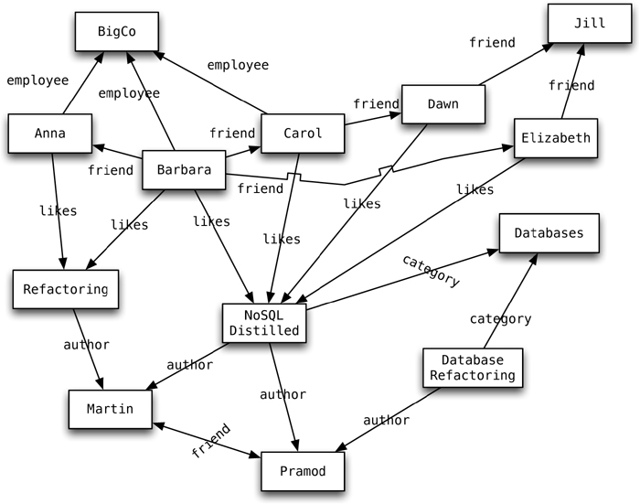
What Is a Graph Database?

Slide 3
Once we have a graph of these nodes and edges created, we can query the graph in many ways, such as “get all nodes employed by Big Co that like NoSQL Distilled.”
A query on the graph is also known as traversing the graph.
If we want to “get all nodes that like NoSQL Distilled,” we can do so without having to change the existing data or the model of the database, because we can traverse the graph any way we like.

Slide 4
Features
Graph databases available Neo4J, Infinite Graph, OrientDB , FlockDB.
We are going to see Neo4J as a representative of the graph database solutions.
creating a graph is as simple as creating two nodes and then creating a relationship.
Node martin = graphDb.createNode(); martin.setProperty("name", "Martin"); Node pramod = graphDb.createNode(); pramod.setProperty("name", "Pramod");
martin.createRelationshipTo(pramod, FRIEND); pramod.createRelationshipTo(martin, FRIEND);
We have to create relationship between the nodes in both directions,

Slide 5
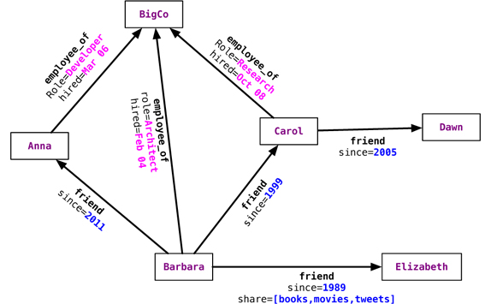
Nodes know about INCOMING and OUTGOING relationships that are traversable both ways.
Relationships with properties

Slide 6
Relationships
Relationships are first-class citizens in graph databases; most of the value of graph databases is derived from the relationships.
Relationships don’t only have a type, a start node, and an end node, but can have properties of their own.
we can add intelligence to the relationship—for example, since when did they become friends, what is the distance between the nodes, or what aspects are shared between the nodes.

Slide 7
Consistency
Graph databases ensure consistency through transactions.
They do not allow dangling relationships: The start node and end node always have to exist,
and nodes can only be deleted if they don’t have any relationships attached to them.

Slide 8
Transactions
Neo4J is ACID-compliant
Before changing any nodes or adding any relationships to existing nodes, we have to start a transaction
Transaction transaction = database.beginTx(); try { Node node = database.createNode(); node.setProperty("name", "NoSQL Distilled"); node.setProperty("published", "2012"); transaction.success(); } finally { transaction.finish(); }

Slide 9
Availability
Neo4J, as of version 1.8, achieves high availability by providing for replicated slaves.
These slaves can also handle writes: When they are written to, they synchronize the write to the current master, and the write is committed first at the master and then at the slave.
Neo4J uses the Apache ZooKeeper to keep track of the last transaction IDs persisted on each slave node and the current master node.
Once a server starts up, it communicates with ZooKeeper and finds out which server is the master.
If the server is the first one to join the cluster, it becomes the master; when a master goes down, the cluster elects a master from the available nodes, thus providing high availability.

Slide 10
Query Features
Graph databases are supported by query languages such as Gremlin.
Gremlin is a domain-specific language for traversing graphs; it can traverse all graph databases that implement the Blueprints property graph.
Properties of a node can be indexed using the indexing service. Similarly, properties of relationships or edges can be indexed, so a node or edge can be found by the value.
Indexes should be queried to find the starting node to begin a traversal. Let’s look at searching for the node using node indexing.
We first need to create an index for the nodes using the IndexManager.

Slide 11
Query Features
Index<Node> nodeIndex = graphDb.index().forNodes("nodes");
Transaction transaction = graphDb.beginTx(); try { Index<Node> nodeIndex = graphDb.index().forNodes("nodes"); nodeIndex.add(martin, "name", martin.getProperty("name")); nodeIndex.add(pramod, "name", pramod.getProperty("name")); transaction.success(); } finally { transaction.finish(); }
Adding nodes to the index is done inside the context of a transaction. Once the nodes are indexed, we can search them using the indexed property.

Slide 12
Query Features
Node node = nodeIndex.get("name", "Barbara").getSingle();
We get the node whose name is Martin; given the node, we can get all its relationships.
Node martin = nodeIndex.get("name", "Martin").getSingle(); allRelationships = martin.getRelationships();
We can get both INCOMING or OUTGOING relationships.
incomingRelations = martin.getRelationships(Direction.INCOMING);
We can also apply directional filters on the queries when querying for a relationship.

Slide 13
Node nosqlDistilled = nodeIndex.get("name", "NoSQL Distilled").getSingle(); relationships = nosqlDistilled.getRelationships(INCOMING, LIKES); for (Relationship relationship : relationships) { likesNoSQLDistilled.add(relationship.getStartNode()); }

Slide 14
Scaling
Any given node can be related to any other node, storing related nodes on the same server is better for graph traversal.
Traversing a graph when the nodes are on different machines is not good for performance.
Knowing this limitation of the graph databases, we can still scale them using some common techniques described by Jim Webbe.

Slide 15
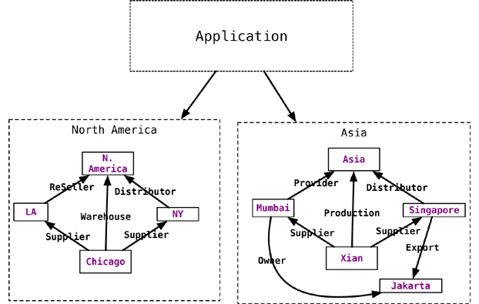
Scaling
Increase the RAM: we can add enough RAM to the server so that the working set of nodes and relationships is held entirely in memory.
Add more slaves with read-only access to the data, with all the writes going to the master

Slide 16
Suitable Use Cases
Connected Data: Social networks are where graph databases can be deployed and used very effectively.
Routing, Dispatch, and Location-Based Services: Relationships between nodes can have the property of distance, thus allowing you to deliver the goods in an efficient manner.
Recommendation Engines: “your friends also bought this product”, or “when invoicing this item, these other items are usually invoiced.”
When not to use: analytics solution

